Slide 1
Rocket Avionics
2/14/2012
Aaron Mitchell

Slide 2
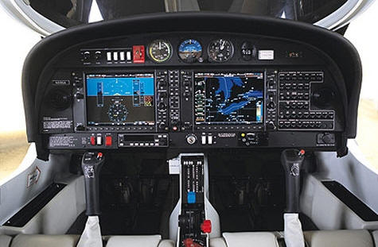

What are Rocket Avionics?
Regular Avionics
Anything electronic on a…
Aircraft
Missile
Satellite/spacecraft
Including…
Navigation
Piloting
Communication
Monitoring
Intelligence
Our Avionics
Rocket recovery systems

Slide 3
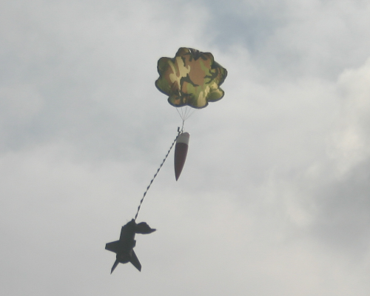
Rocket Avionics: Goals
Primary Goal: RECOVERY!
To deploy the parachute needs:
Method of deployment
Know when to deploy
Secondary Goals
Data Collection
Radio Beacons
Telemetry
GPS location
Extra Intelligence
YES!!!

Slide 4
Recovery
Simply Difficult.

Slide 5
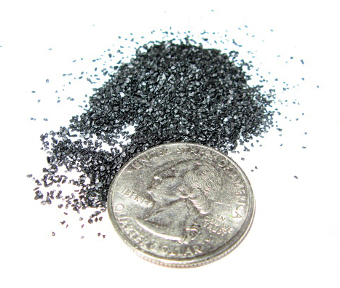
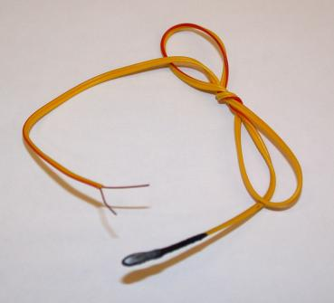
Parachute Go Forth!
Parachute deployment
Black powder charges
Compressed neutral gas
Pneumatic piston
All triggered by electronics
Almost always using
the all-powerful…..
…..E-Match!
Special resistor ignites when
given correct current.

Slide 6
Altimeter
Keep track of altitude
Bonus: Detonate charges
We used to use ARTS board
2 Pyro Channels
$180
Now use Featherweight Raven
4 Pyro Channels
$155
¼ the size!

Slide 7
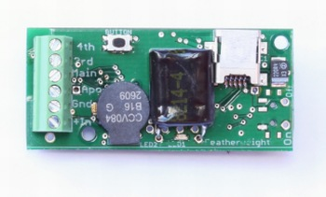
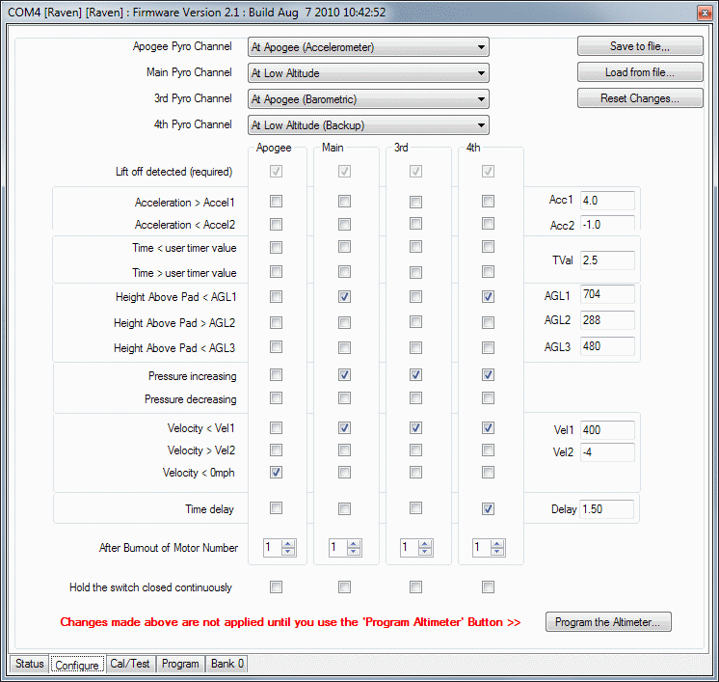
Raven
Programming Interface Included
Used to Program 4 Pyro Channels
Includes:
Single-Axis Accelerometer
Barometer
Timer
Bunch of safety features (elementary-school level intelligence)

Slide 8
Intelligence and Decision Making
Can you say Microcontrollers!

Slide 9
Microcontroller
Programmable mini-computer
Hobby models include ports to easily read/write voltage signals
Analog, digital, or both!
Lots out there
Many different languages
Many different applications
Not all user friendly!
Which one do we use?...

Slide 10
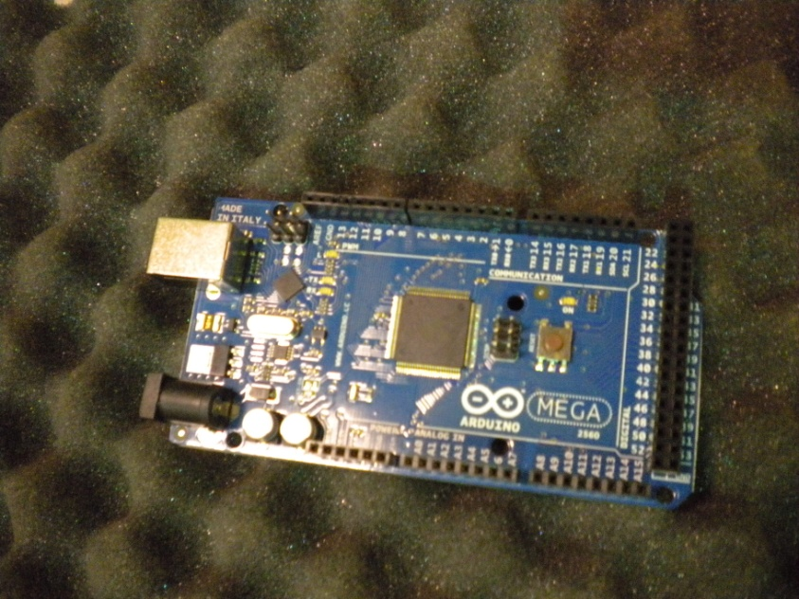
Arduino!
Arduino = MatLAB of microcontrollers
Has it’s own language
Support community
Free code development kit
Lot of FREE help with code
Very versatile!
Balance of easy coding and capability

Slide 11
Programming
Brains?

Slide 12
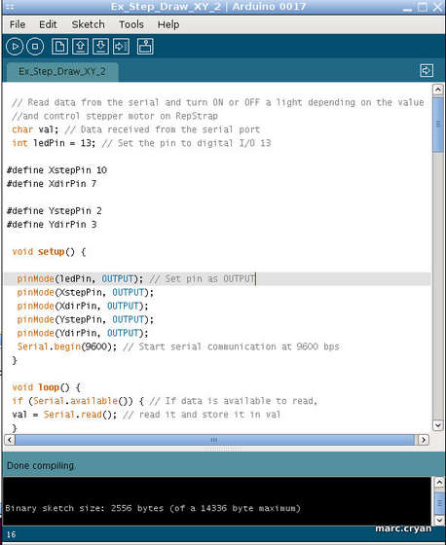

Programming?
Just kidding. (sample arduino code – normal persons face)

Slide 13
Telemetry and GPS
Marco…

Slide 14
Telemetry
Why is it not easy?
Transmitting signals is not easy when:
Supersonic
Vibrating like crazy
Temperature fluctuations
Made of carbon fiber (not RF transparent)
PLUS. We have to receive those signals
Means investing in expensive ground station equipment
HAM radio licenses
Transmitter not easily tracked
Loss of line of sight on the way down

Slide 15
GPS
Important attributes
Power (aka range)
Antenna (satellite antenna)
Acquisition Time
Programmability
Lock-out (civilian models only)
Lock out occurs at either
18 km altitude (11 mi)
515 m/s (1152 mph, ~1.5 Mach)
Both, varies by manufacturer

Slide 16
Our System
Definitely Experts

Slide 17
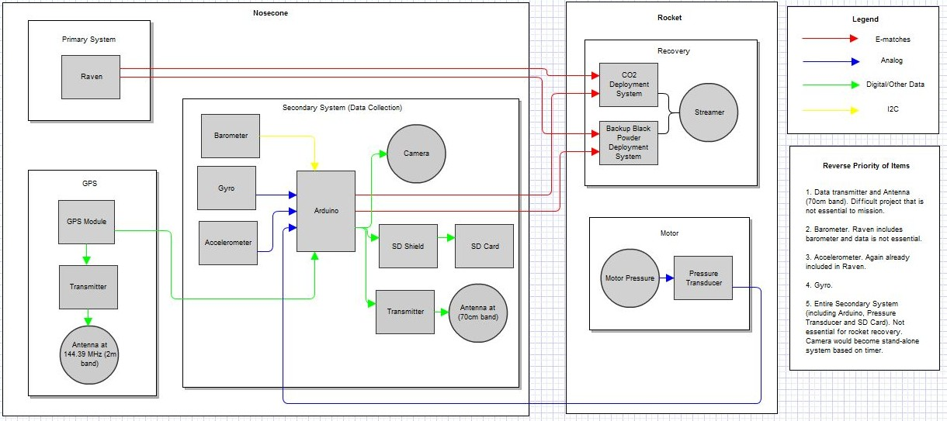
Early Planning

Slide 18
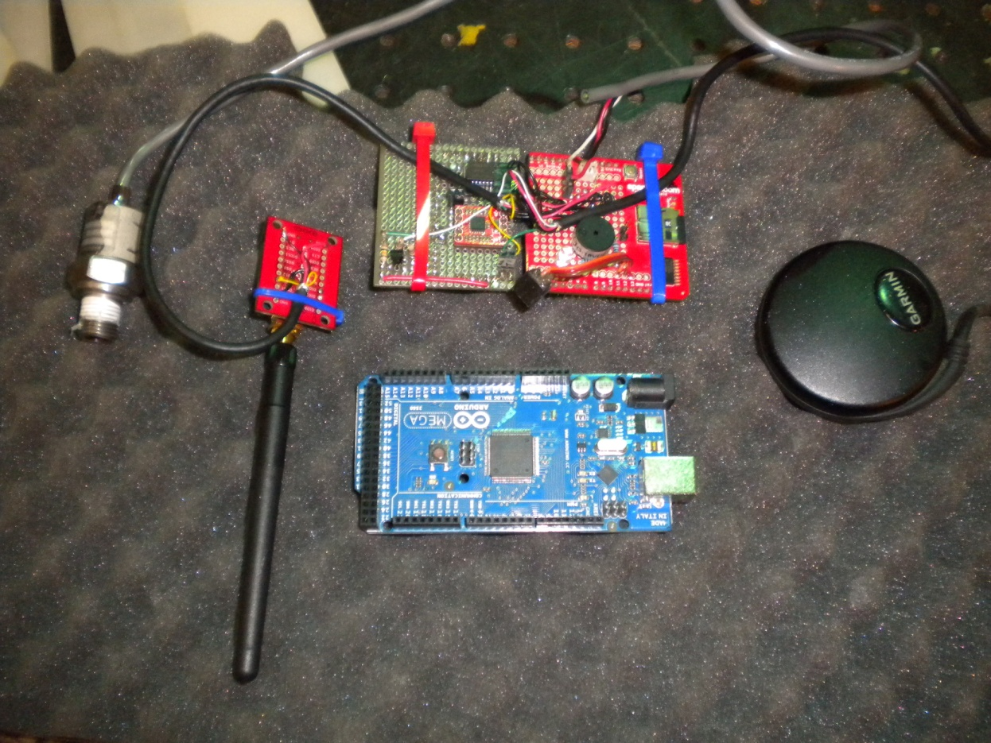
Arduino System
Pressure transducer, transmitter, proto board, Garmin GPS, Arduino MEGA. Transmits on 900 MHz frequency.

Slide 19
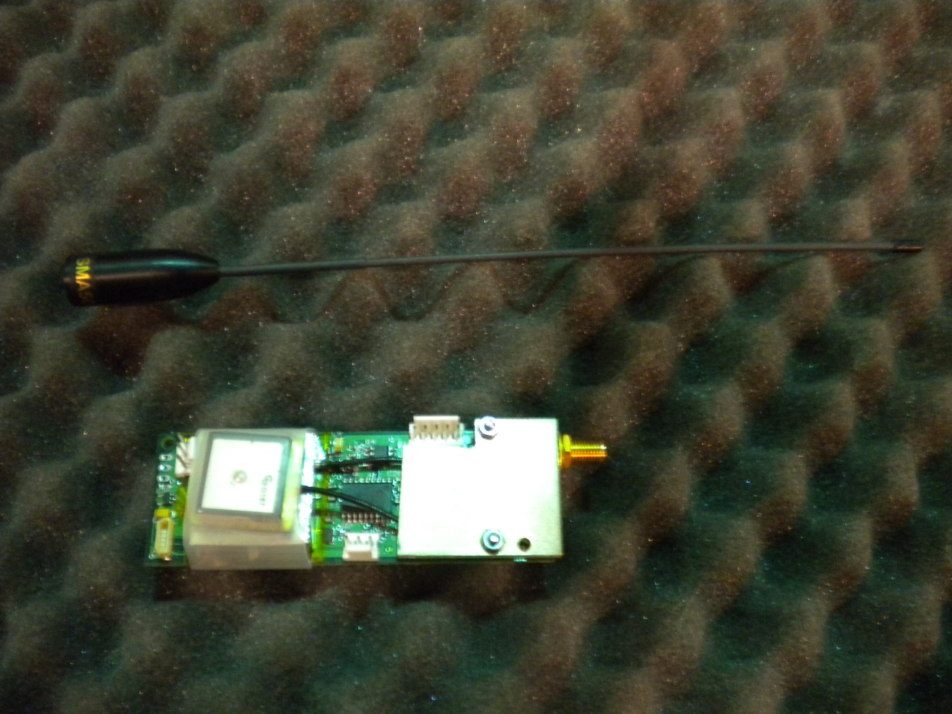
Big Red Bee GPS System
Most powerful system, transmits on 2m band.

Slide 20
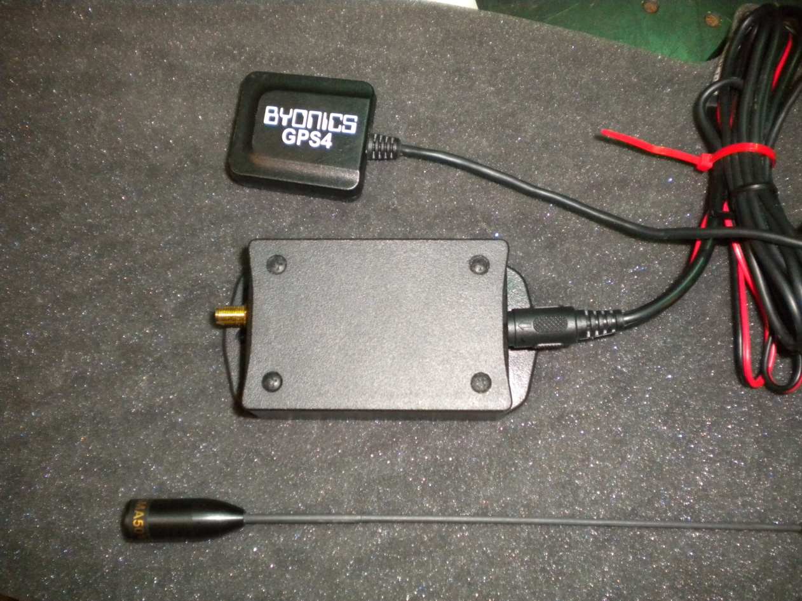
Byonics GPS System
Also transmits on 2m band, just less frequently. Redundant system designed to last days.

Slide 21
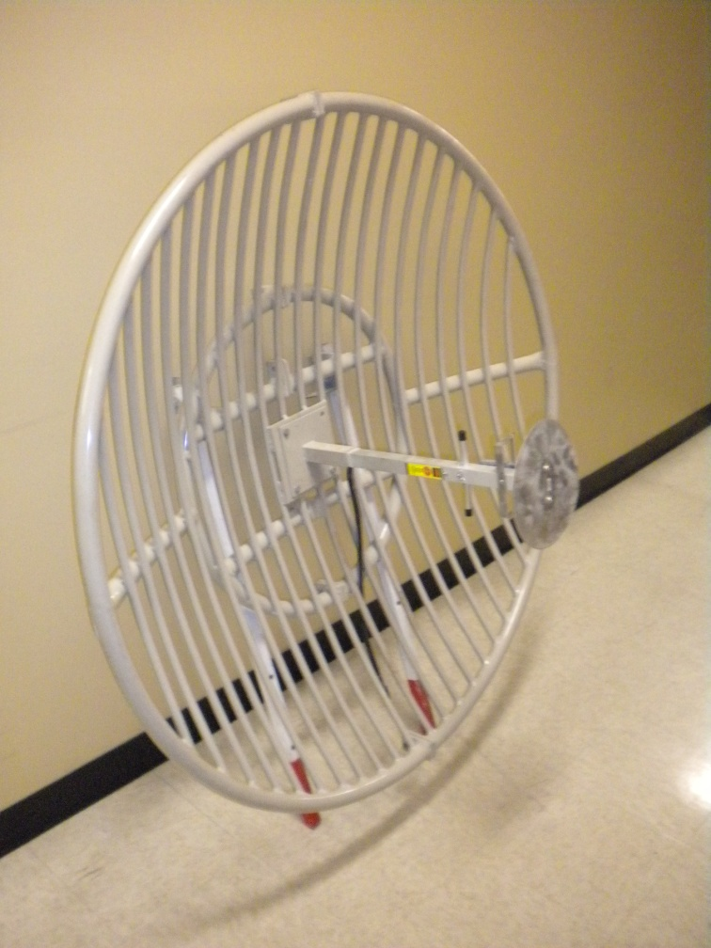
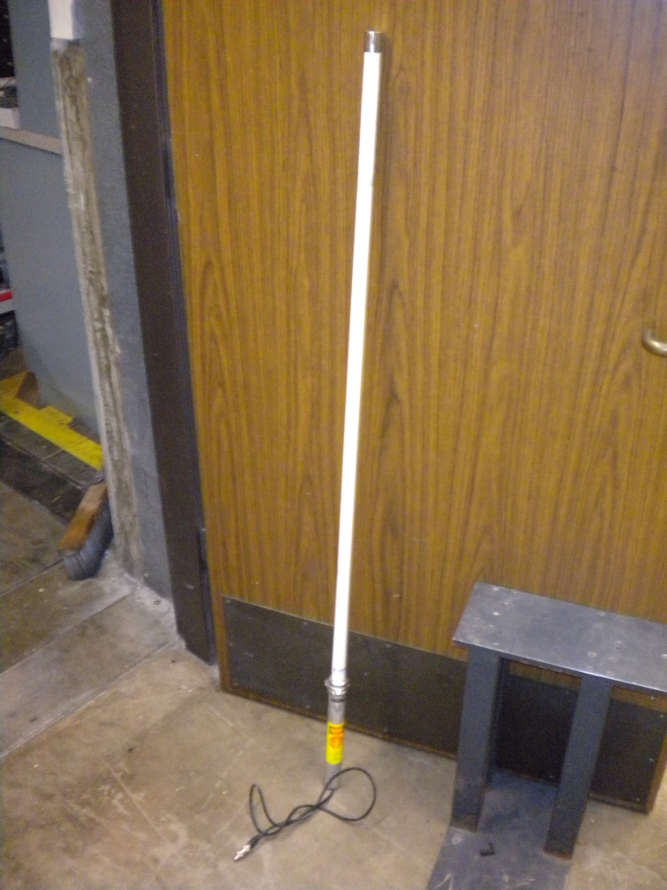
Ground Systems
900 MHz Dish Antenna, 2m Dipole Antenna

Slide 22
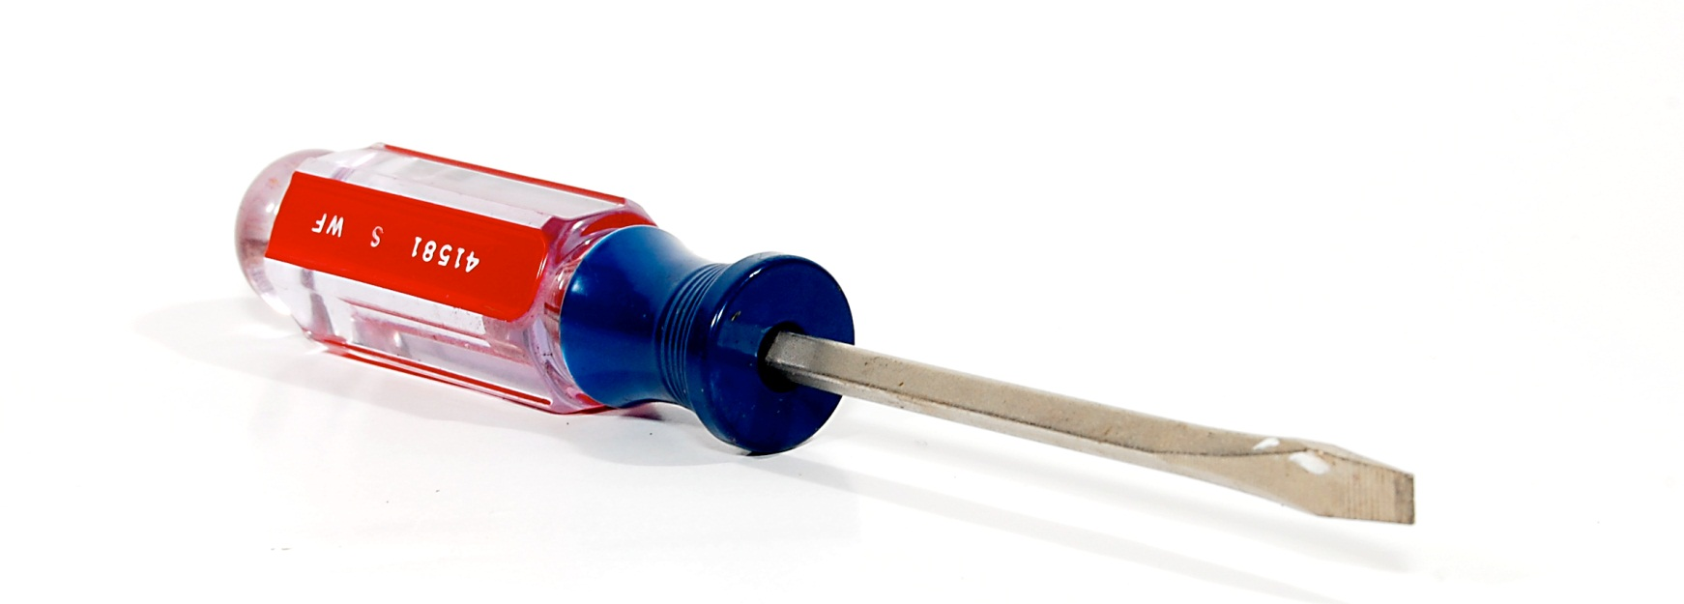
Pop Quiz Review: WTF is this??

